Slide 1
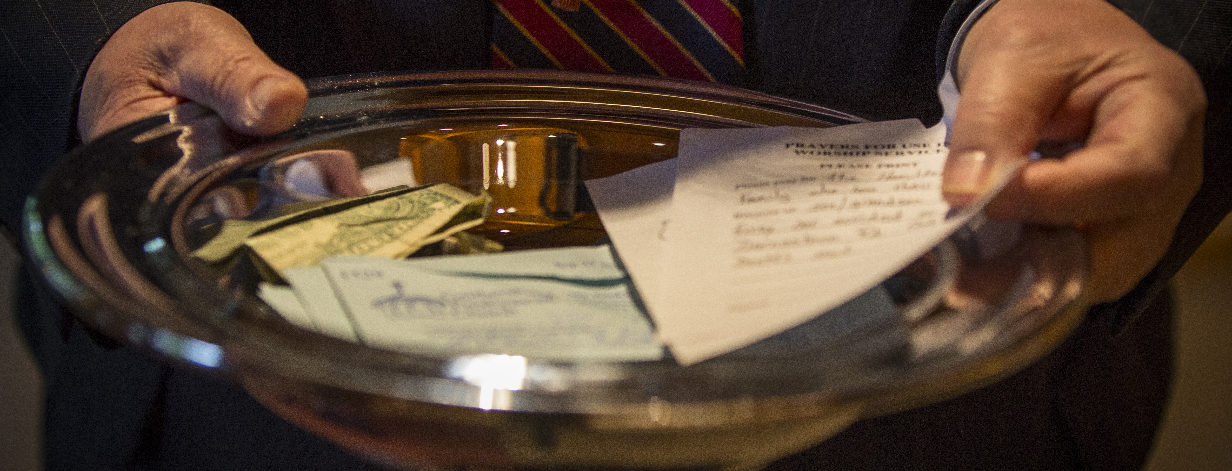
Culture of Generosity part one

Slide 2
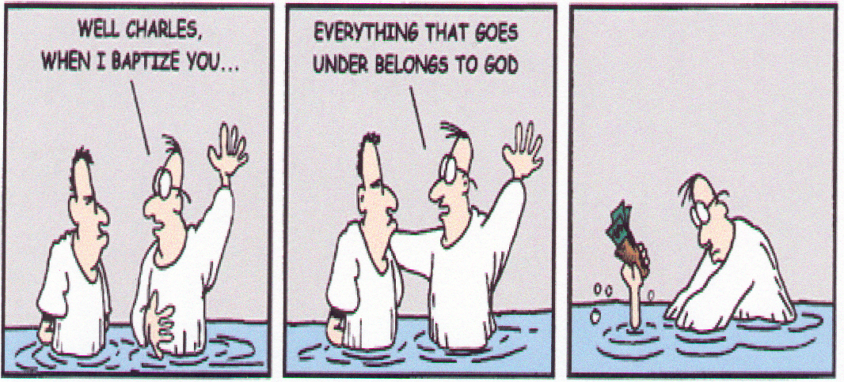

Slide 3
“But I will say this to encourage your generosity: the one who plants little harvests little, and the one who plants plenty harvests plenty. Giving grows out of the heart…..God is ready to overwhelm you with more blessings than you could ever imagine so that you’ll always be taken care of in every way and you’ll have more than enough to share.”
2 Corinthians 9:6-8

Slide 4
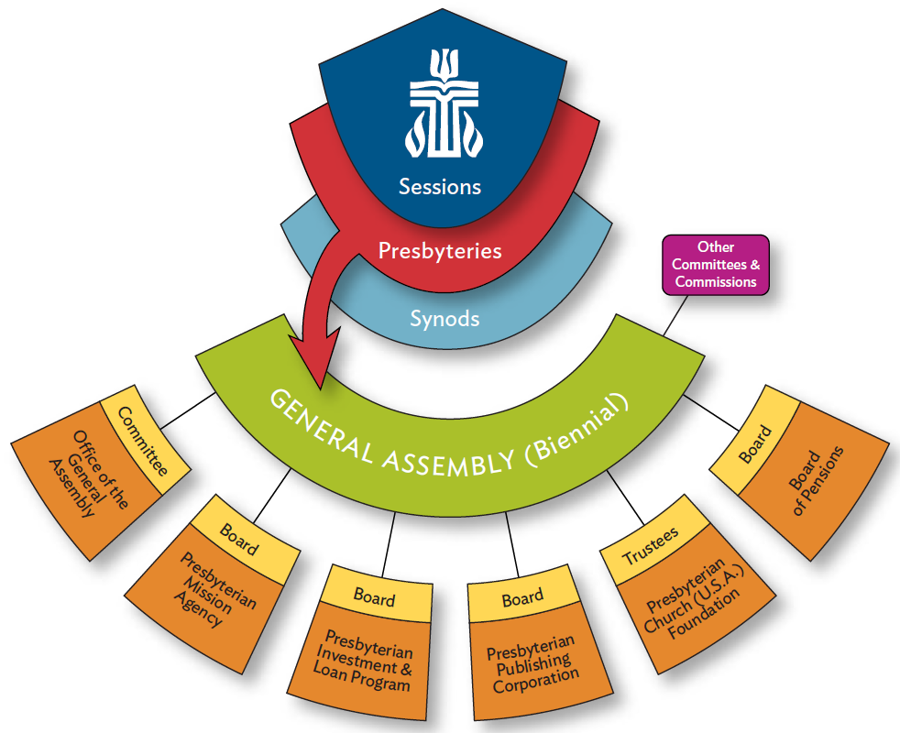

Slide 5
Presbyterian Foundation
A vital part of the Presbyterian Church (U.S.A), the Foundation cultivates, attracts, and manages financial resources of individuals and institutions to serve Christ’s mission.
Established in 1799
Bringing People and Mission Together

Slide 6
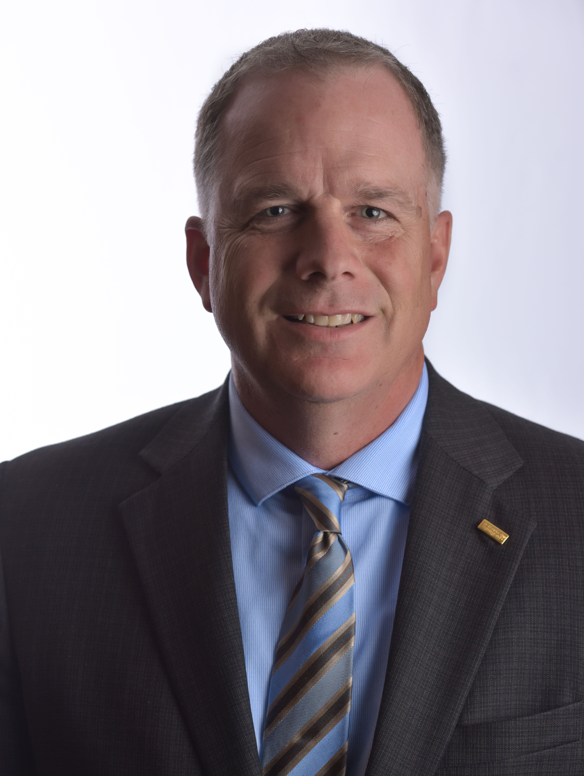
Presbyterian Foundation
Dr. Stephen Keizer
Vice President – Ministry Relations
Presbyterian Foundation
5740 W Heverly Dr
Portage MI 49024
866-317-0751
stephen.keizer@presbyterianfoundation.org

Slide 7
What is Stewardship?
“Where your treasure is, there your heart will be also.” Matthew 6:21
Stewardship is the church’s theological antidote to the chief idols of our age; consumerism, materialism, and acquisition.
Stewardship is about the joyous discipline of thanking God with the way we live our lives and spend and share our money.

Slide 8
What is Stewardship?
Gratitude
Spiritual Growth
About making choices
Caring for all that God has given us
Time, Talent, AND Treasure
Disciple making

Slide 9
Gratitude
Stewardship starts with Gratitude
It is the about the joyous discipline of giving thanks
Abundance vs. Scarcity

Slide 10


Recognition - Saying Thank You
Pastor-written thank-you notes- Personalized letter-ten notes a week
Session-written thank-you notes
Generosity Team writes thank-you notes
Phone calls
Annual celebration
Legacy Society event

Slide 11

Time, Talent and Treasure
Stewardship is a three-legged stool
It is not an ‘either or’ but an ‘and’

Slide 12
Stewardship is not:
A once-a-year event
About money
Fundraising (but we have things to learn from effective fundraising principles)
Meeting a budget
About us (as individuals or as a church)

Slide 13
A Theology of Stewardship
What is your first memory of stewardship?
Who taught you about stewardship?
Why is giving to the church important to you?

Slide 14

Diagnostic
Questions
Is your congregation’s approach to stewardship stuck in a rut?
Are you living in a state of scarcity and longing for abundance?
Do you long for your church’s members to enjoy the spiritual rewards of a generous life?
Notes:
These questions are to help you to find where you may fit in regards to your giving in the church in which you serve.
Stuck means that there seems to be a rote feeling to stewardship. Where do we go from here you might. If you are bored means congregation is with you.
In a small group when I shared that things were tight in the Hagan household, a goof friend who had been in the group for ten years with us said, “Rob you will never have enough money. “ Abundance is a prime emphasis of the workshop
Generosity is infectious. We are doing something today that is suversie. In an age of scarticity we are going to talk about abundance. Peterson quote

Slide 15
Changing Landscape
Christian share of population has fallen between 2007 and 2014 from 78.4% to 70.6%
Median age of mainline Protestant adults is 52, up from 50 in 2007
Millennials display much lower levels of religious affiliation, 36% of millennials age 18-24 and 34% of millennials age 25-33 are religiously unaffiliated
Pew Research Center
2014 Religious Landscape Study

Slide 16
Giving Trends in US Philanthropy
In 2015……………
$373.25 billion to charity
This represents a 4.1% increase from 2014

Slide 17
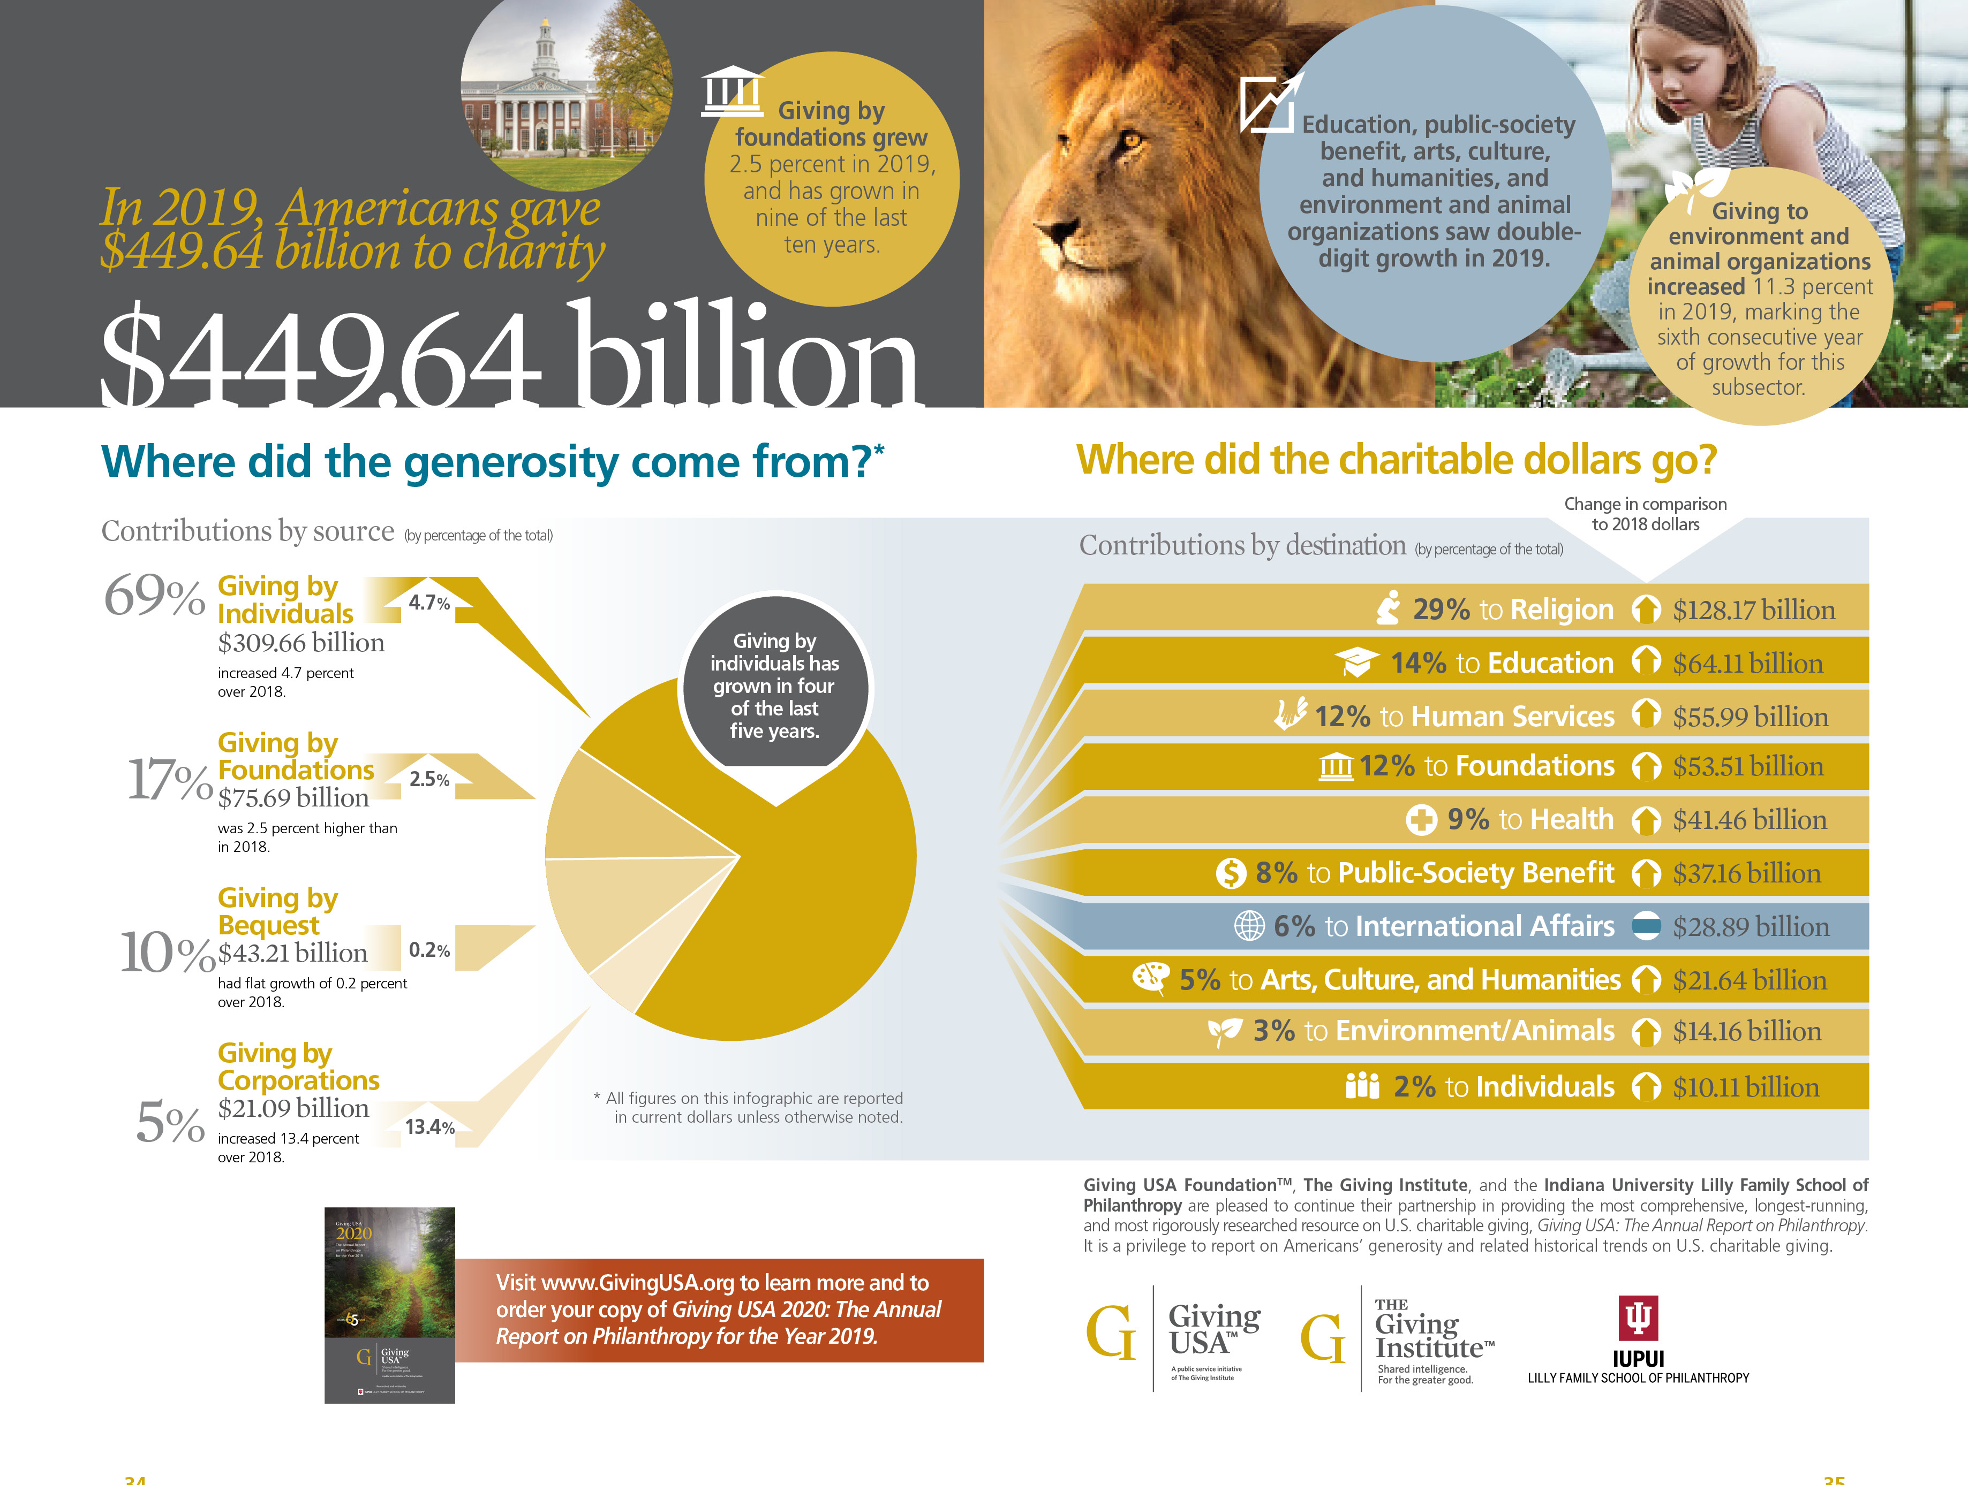

Slide 18
Giving Trends in US Philanthropy
Giving to Religion
1990 – 1994 51%
1995 – 1999 41%
2000 – 2004 38%
2005 – 2009 35%
2010 – 2014 33%

Slide 19
Giving Trends in US Philanthropy
COMPETITION! COMPETITION! COMPETITION!
Estimated 1.5 million charitable organizations
in the US
Only about 316,500 are congregations

Slide 20
Donor Motivation
Top Three Things impacting a donor’s decision to support your organization
    Making an impact
    Financial stability
    Believe in leadership

Slide 21
Giving Trends in US Philanthropy
Six specific characteristics about giving based on philanthropic giving trends
Donor Driven – defined by generational characteristics
Relationship Focused – giving is influenced by relationships

Slide 22
Giving Trends in US Philanthropy
Choice Abundant – literally millions of choices
Boundary Bereft – gifts come from a variety of sources
Time Transcendent – ways to give are available 24/7/365
Information Rich – mission and transparency are essential

Slide 23
Donor Driven
How do you measure up?
Is your congregation’s message meaningful to different generations?
Best practices for generous churches:
Create generationally focused giving opportunities

Slide 24
Giving Trends in US Philanthropy
Builders Boomers Net-Gen Millennials
born born born born
1945 & before 1946 – 1964 1965 – 1979 1980 – 2000
Money is to be Money is to be Money is to be Money is
Saved spent invested borrowed
Loyal to Loyal to Loyal to Loyal to
denomination congregation program person(s)

Slide 25
Relationship Focused
How do you measure up?
Are your members encouraged to leverage their relationships to support your mission and ministry? Do they know how?
Best practices for generous churches:
Engage more persons in your congregational stewardship activities

Slide 26
Choice Abundant
How do you measure up?
Are your invitations to give truly inviting?
Best practices for generous churches:
Develop or re-visit your church’s mission statement

Slide 27
Boundary Bereft
How do you measure up?
What giving opportunities do you offer beyond regular annual giving?
Best practices for generous churches:
Create a process for promoting and receiving legacy gifts

Slide 28
Time Transcendent
How do you measure up?
What giving opportunities do you provide beyond the Sunday morning offering plate?
Best practices for generous churches:
Provide giving opportunities beyond the offering plate

Slide 29
Information Rich
How do you measure up?
Do your members know how their gifts are making a difference?
Best practices for generous churches:
Develop a communications plan that lets members know their gifts make a difference

Slide 30
What is your story?
What is it you do well? In your church, in your community, in the world?
How are you being the hands and feet of Christ?
Celebrate your church
Create energy about the church
Invite people to engage in the church

Slide 31
Cultivation
HOW do we tell our story?
Preaching
Minute for mission
During/before offering
Newsletter/E-Newsletter
Brochures
Town Hall Meetings
Vision Sunday and 6 month checkup
Dessert & Dialogue
Sunday School
Testimonials
Video Testimonials
Narrative Budget

Slide 32
Keys to Success
Be Prayerful
Celebrate your Church
Be visionary
Communicate
Involve many
Fund ministry, not raise funds
Be inviting not threating
Challenge your Congregation

Slide 33
Culture of Generosity part two

Slide 34
How do People Give
Income Pocket
Capital Pocket
Estate Pocket

Slide 35
Ways people can give
(MAKE IT EASY)
Cash
Check
Online Bill Pay
Credit/Debit Card
Bank draft
Securities

Slide 36
BUDGET
Line Item vs Narrative
Accounting Tool
DO NOT show how money is being invested
DO NOT show how volunteer time and talents are impacting the church
Should be used by the session
Visioning Tool
Shows the programs of the church having a positive impact
Inspires and helps us see our gifts are really making a difference
Help us to reframe finances to be about ministry

Slide 37
Steps toward creating your first Narrative Budget
Define your “Ministry Areas”
Allocate staff time to each area
Allocate all other resources proportionally to each area
Consider adding volunteer time to each area
Write about the successes of the past year in each area

Slide 38
Stewardship Campaign
Annual vs Year Round
Annual Campaign ties to strategic plan
Volunteers own budget and need for resources
Narrative Budget
Ask for the investment not the gift
Teach Tithing
Teach financial planning and debt management

Slide 39

Six elements of an effective Financial Stewardship Campaign
Identify and celebrate what members value in their congregation
Inform members how their gifts are being used
Challenge members to a higher level of giving
Secure a financial commitment from members
Affirming members and acknowledging their response
Evaluate your program
Notes:
C. Understand What Motivates People to Give
Money to a Congregation. A survey of 26,184,335 people
from 15 denominations revealed the seven greatest motivations
for giving money to a church: (1) I am grateful to God.
(2) Giving is part of my spiritual relationship to God. (3) I
feel privileged to serve. (4) God asks for an appropriate
percentage of my income. (5) I like to help other people. (6)
I want to help my church. (7) Giving adds meaning to life.
Items at the top of that list motivate far more people to
give than do items at the end of the list.(Douglas W. Johnson
and George W. Cornell, Punctured Preconceptions [New

Slide 40

Campaigns
Consecration Sunday
Sunday Campaigns
Direct Mailing Campaigns
All member visitation campaigns
Notes:
with annual stewardship campaigns recognize three important facts:
• Few people spontaneously decide to grow spiritually through their financial giving.
Seldom is someone driving down the street toward the grocery store overcome by the
spiritual conviction, “I need to increase my giving to the church.”
• People listen to God’s call to increase their giving when someone asks them to
consider increasing it. That happens best in an personal, spiritually-focused annual
stewardship campaign.
• People who put their financial commitments on paper give an average of twice as
much as people who do not put them on paper.
The Bottom Line
Stifle the inclination to introduce giving appeals with statements
such as, “I wish we didn’t have to talk about money,
but ....”
Instead, make statements such as, “Our annual stewardship
campaign is an opportunity for each of us to reflect
on the spiritual connection between generous giving and becoming
rich toward God.”

Slide 41
Pastors
Talk about their own stewardship
Preach about generosity regularly
Be a story teller
Invite/ask
Say Thank You

Slide 42
Session
Shares their stories
Supports the process
Be pledgers/tithers
Be leaders in stewardship

Slide 43
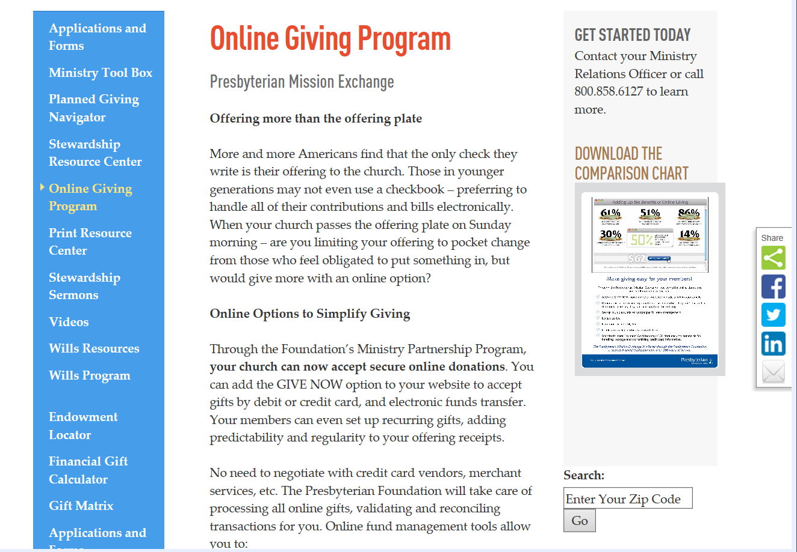

Slide 44
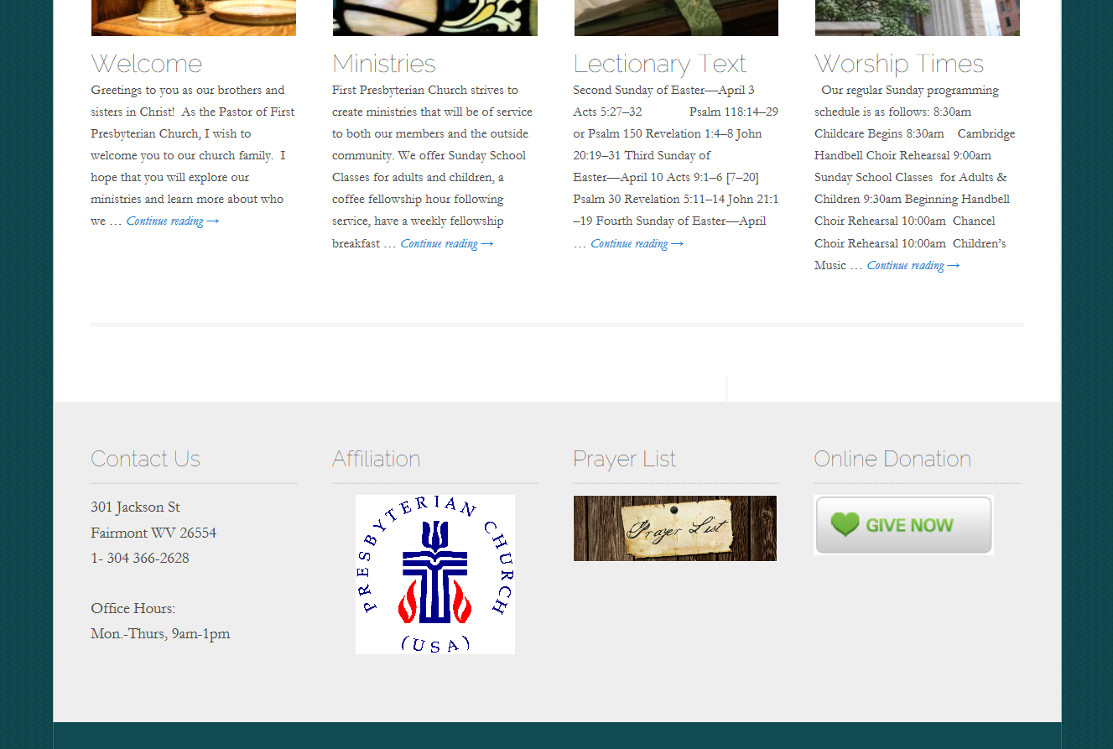

Slide 45

Planned Giving

Slide 46
Planned Giving Program
Keep the Pastor involved
Lay leadership has to be givers to the endowment (donors won’t support something if the leadership doesn’t support it)
Marketing plan
Thank-you event
Celebrate when the endowment makes a difference
Legacy Society

Slide 47
Planned Giving Program
Three Major Components
Legacy Funds
  Spending Legacy Funds
  Investing Legacy Funds
  Growing Legacy Funds

Slide 48
Resources
www.presbyterianfoundation.org
www.stewardshipnavigator.org
www.newcovenantfunds.com
www.newcovenanttrust.com
www.stewardshipresources.org

Slide 49
References
Bolsinger, Tod. Canoeing the Mountains – The Church in Uncharted Territory. Downers Grove: InterVarsity Press - Praxis, 2015.
Christopher, J. Clif. Whose Offering Plate Is It?. Nashville: Abingdon Press, 2010
Christopher, J. Clif. Not Your Parents’ Offering Plate. Nashville: Abingdon Press, 2015
Christopher, J. Clif. Rich Church, Poor Church. Nashville: Abingdon Press, 2012
Christopher, J. Clif. The Church Manual. Nashville: Abingdon Press, 2014
Enright, William G. Kitchen Table Giving – Reimagining How Congregations Connect with Their Donors. Columbia: 2019
Gray, Joan S. Sailboat Church. Louisville: Westminster John Knox Press, 2014

Slide 50
References
Jamieson, Janet T. and Jamieson, Philip D. Ministry and Money – A Practical Guide for Pastors. Louisville: Westminster John Knox Press, 2009
Lane, Charles R. and Duddy Pomroy, Grace. Embracing Stewardship. Maple Grove: Embracing Stewardship, LLC, 2016
Law, Eric H. F. Holy Currencies – 6 Blessings for Sustainable Missional Ministries.
St. Louis: Chalice Press, 2013 (Gifted to all of us by Steve Wirth)
McKenzie, Scott and Miller, Kristine. Bounty. Nashville: Abingdon Press, 2013
Nouwen, Henri J. M. A Spirituality of Fundraising. Nashville: The Upper Room, 2011
Panas, Jerold. Asking. Medfield: Emerson & Church, 2009
Stanley, Thomas J. Ph.D. and Danko, William D. Ph.D. The Millionaire Next Door. Boulder: Taylor Trade Publishing, 1996

Slide 51
Don’t judge each day by the harvest you reap,
but by the seeds you plant.
Robert Louis Stevenson

Slide 52

Presbyterian Foundation

