Slide 1
Presbyterian Foundation
A vital part of the Presbyterian Church (U.S.A), the Foundation cultivates, attracts, and manages financial resources of individuals and institutions to serve Christ’s mission.
Established in 1799
Bringing People and Mission Together

Slide 2
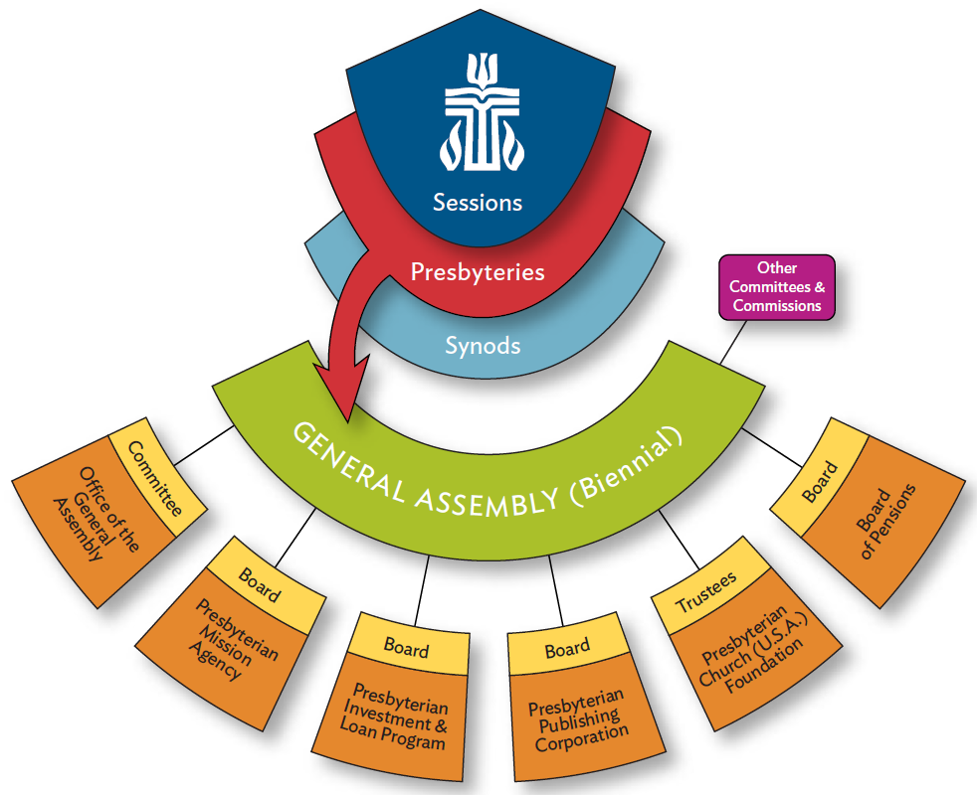
“PCUSA Interim Unifying Agency”

Slide 3

Rev. Sandra Moon
Ministry Relations Officer –
Northwest Region
502-457-5641
sandra.moon@presbyterianfoundation.org

Slide 4
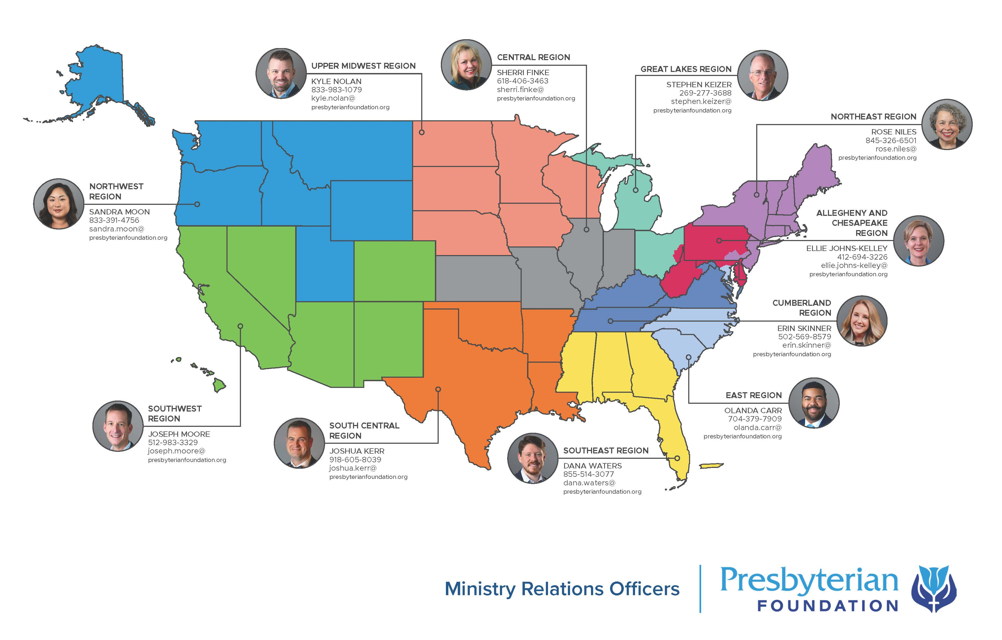

Slide 5

Services
Pooled Income Funds
Donor Advised Funds
Investment Services
Presbyterian Endowment Service
Faith-Based Investing
Online Giving Program
Church Financial Health Assessment
Center for Print Resources
Church Financial Literacy resources and grants
MROs are available to lead workshops on generosity, stewardship best practices, planned giving programs, and more!

Slide 6
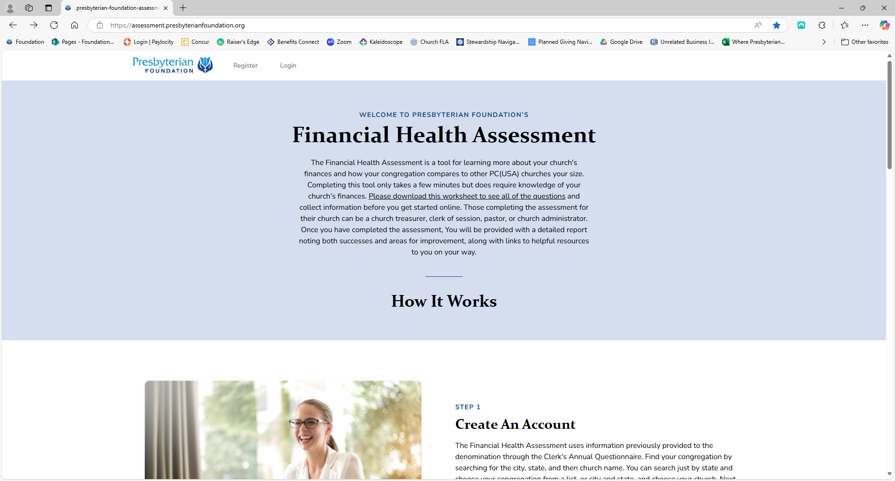
Church Financial Health Assessment
https://assessment.presbyterianfoundation.org

Slide 7
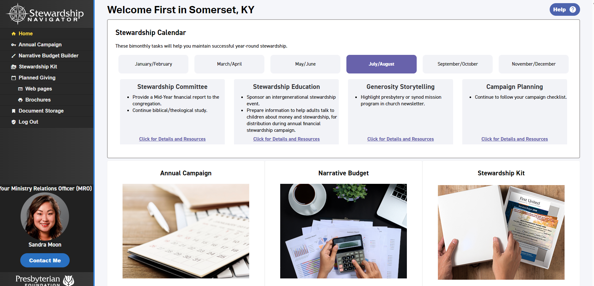
Stewardship Navigator
www.stewardshipnavigator.com
Free resource for PCUSA
Launched April 2019
Over 2,200 users
Over 1,400 churches

Slide 8
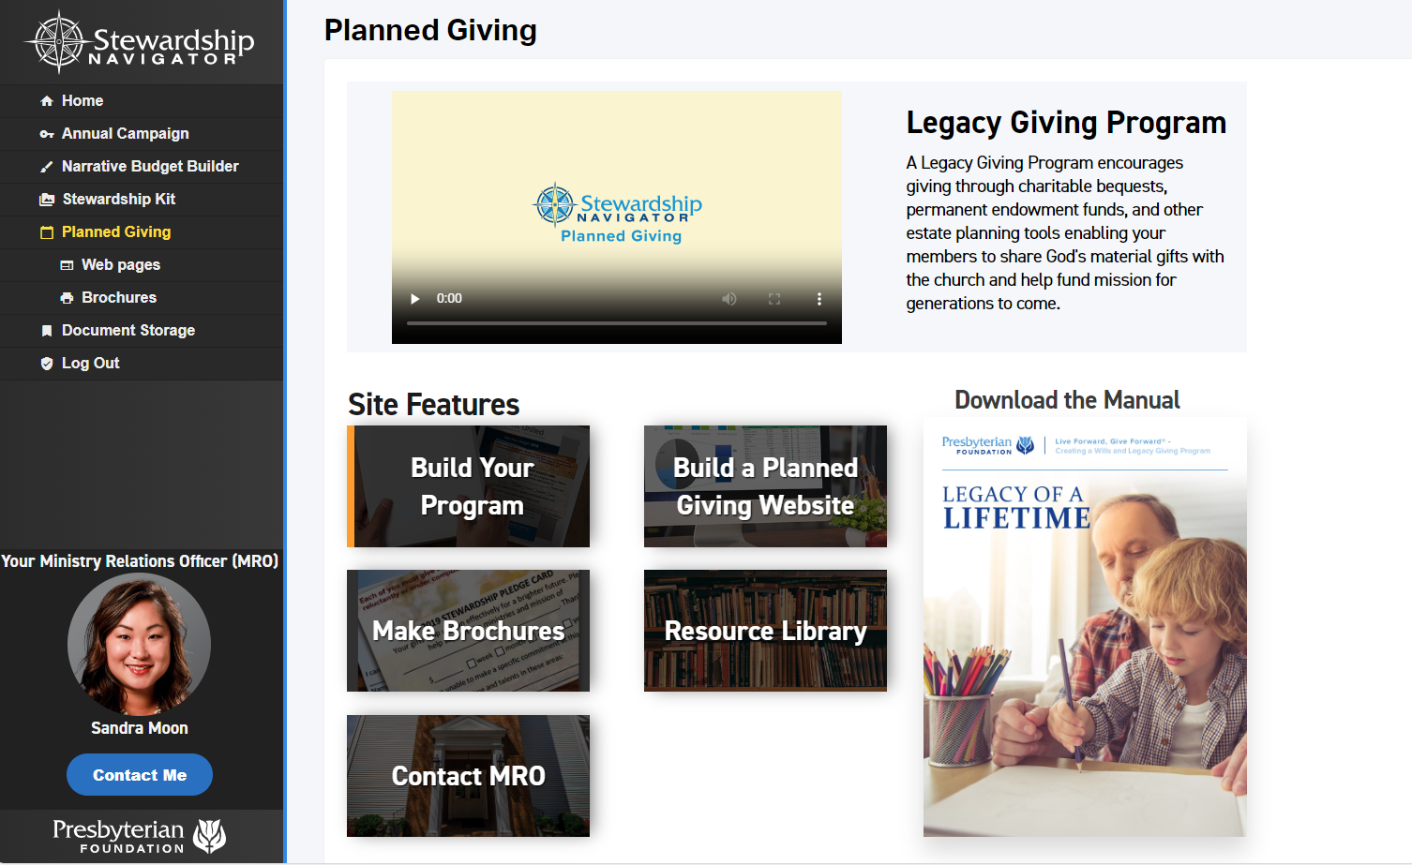
Stewardship Navigator

Slide 9
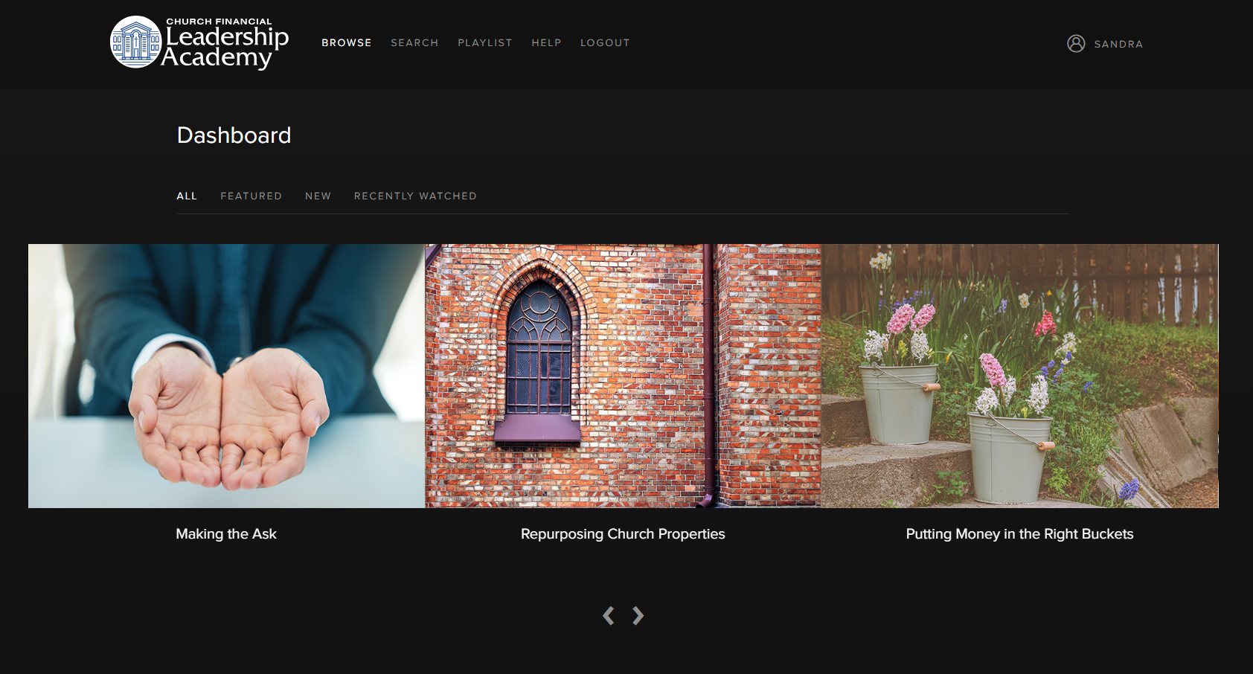
Church Financial Leadership Academy
www.churchfla.com
Free resource for PCUSA
Launched May 2020
Over 500 users
More videos to be added
Registration code: pcusa

Slide 10
Rev. Sandra Moon
Ministry Relations Officer –
Northwest Region
502-457-5641
sandra.moon@presbyterianfoundation.org

