Slide 1

All About Commissioned Pastors what is required, discerning God’s call and more
Rev. Kristin Rice, Moderator of the Commissioned Pastor Sub Committee
April 13, 2026

Slide 2
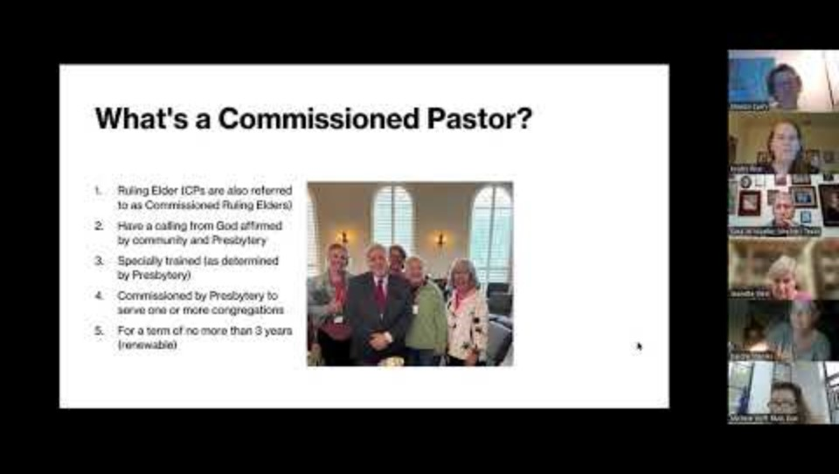

Slide 3



The Third Monday of each month at 7:oo PM via Zoom
Zoom links are emailed on the morning of each gathering.
Email sharon@gracepresbytery.org to receive your link.
All are welcome!
Get In Touch!
214.630.4502
6100 Colwell Boulevard Irving, Texas 75039
info@gracepresbytery.org
Notes:
We hope you will join us for future Small Church Zoom Gatherings on the third Monday of each month at 7 PM. Drop me an email to receive your link.
Blessings and peace, my friends. May God be with you until we meet again.

